Slide 1
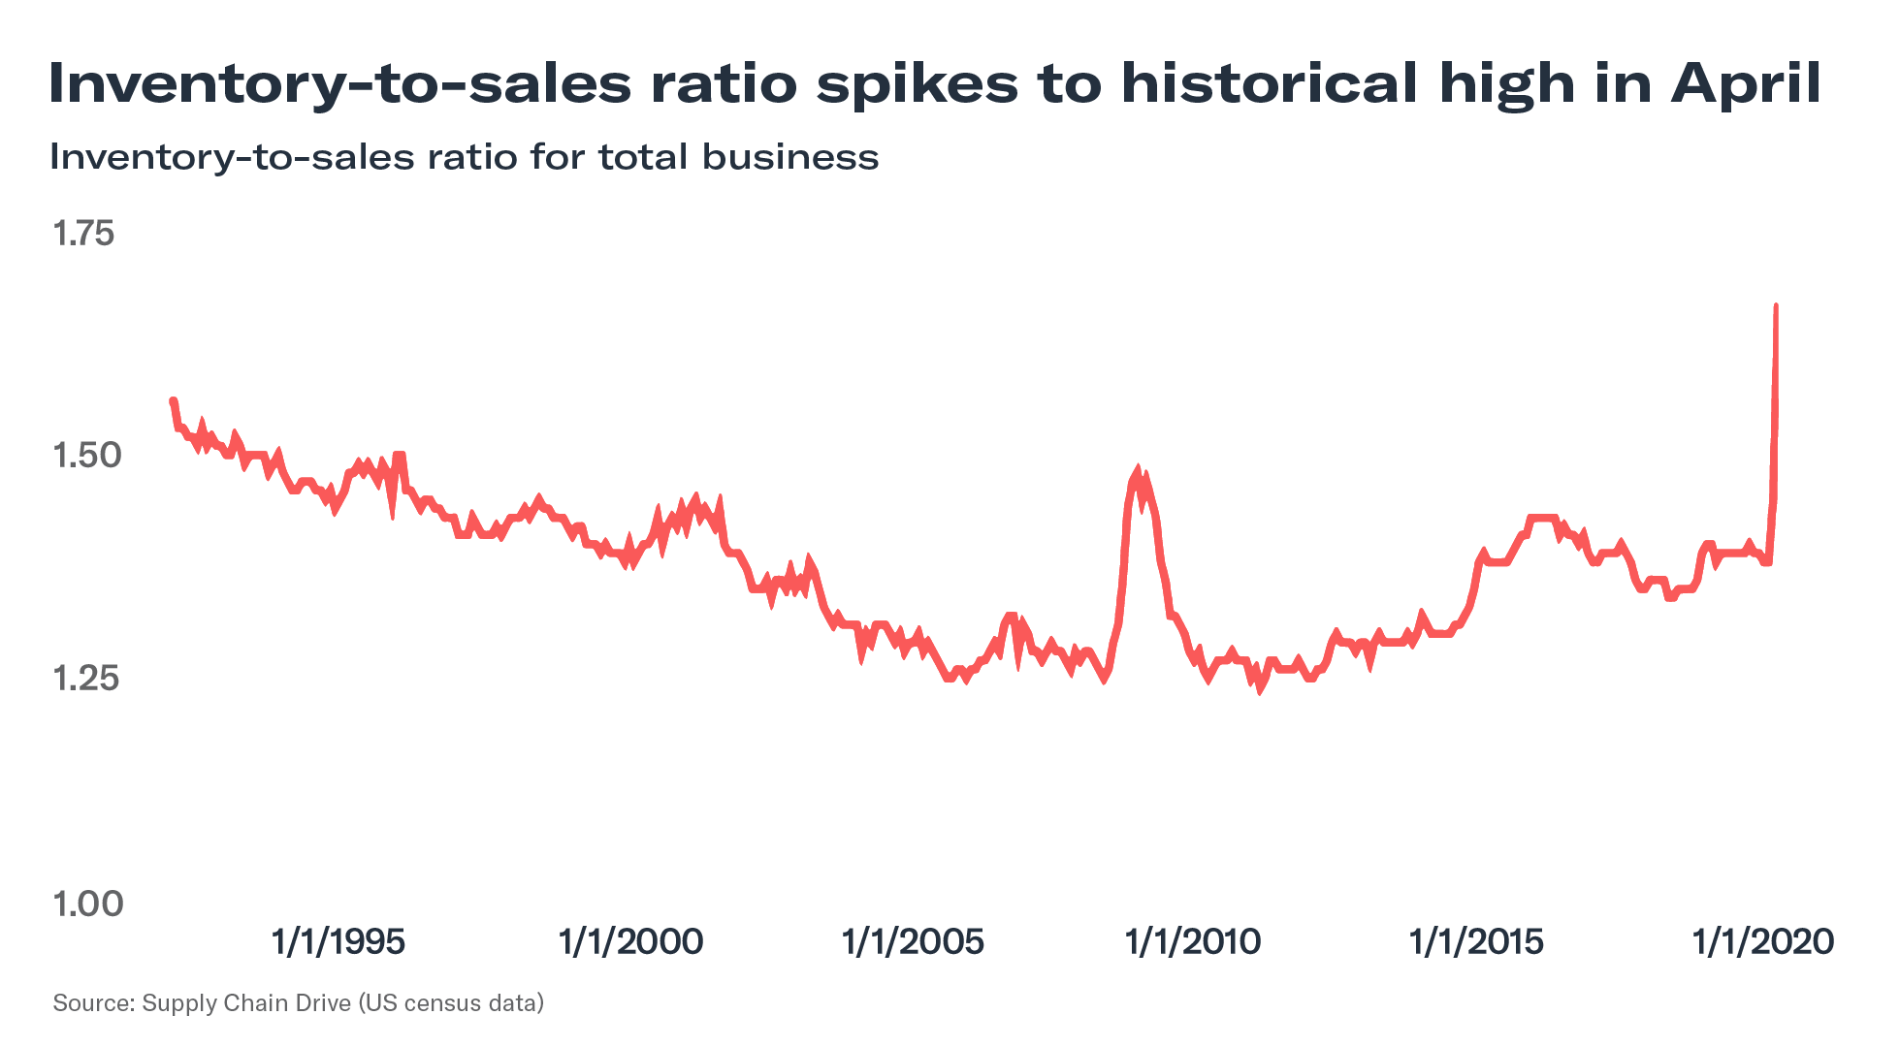
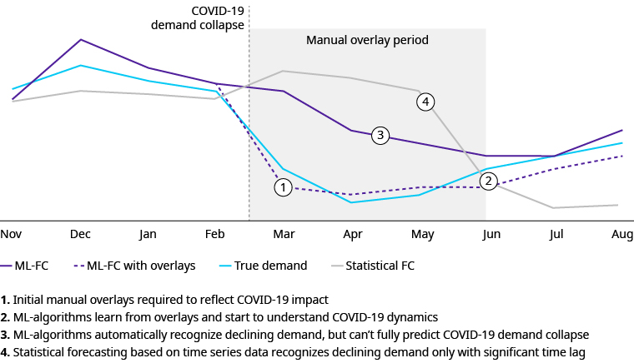
Rethinking Inventory Management in the Age of COVID-19
Machine Learning forecasting platform
Covid-19 overlays
New inventory levels
Order book realignment
Track and Trace
Notes:
Retail inventory-to-sales ratio, which looks at how much inventory is being carried in comparison with how much is being sold, reached an 18-year high in April—a clear outcome of COVID-19. The increase in e-commerce sales was not enough to make up for the store closures. In fact, it left many businesses heavily overstocked. As a result, this forced many to put inventory into storage or clear it at low prices that heavily impacted margins.
For instance, Macy’s Inc. wrote down about $300 million for the first quarter, flagging merchandise issues; Kohl’s cleared large volumes, cutting their gross margin from 38% in 2019 to 17% in 2020 for the three-month period ending May 2.
The fallout of overstock, combined with the ongoing uncertainty in customer traffic and buying behavior, has put retailers in a tough spot. Illustrating the point, Nordstrom Inc. recently told the LA Times that its stores were relatively bare of products soon after reopening because of a more “conservative approach” to stocking, to avoid being saddled with excess goods. Gap Inc. has also said it has tightened its inventory and is holding some items for next season.
https://www.zensar.com/blogs/2020/05/ai-in-manufacturing-tackle-covid-19-impact-on-inventory-and-warehouse-management/
https://www.flexport.com/blog/rethinking-inventory-management-in-the-age-of-covid-19/

Slide 2
Rough

Slide 3
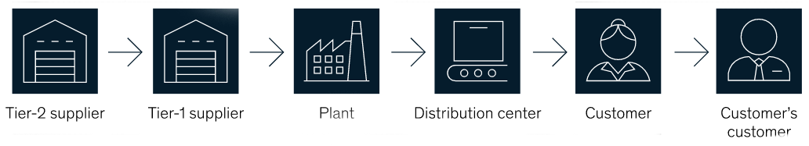
AI in inventory and warehouse management
Advanced demand forecasting systems to manage inventory planning
Automated Visual Inspection for quality assurance
Increased focus on robotic technology
Remote predictive maintenance of equipment
Employee health and social distancing in warehouses

Slide 4
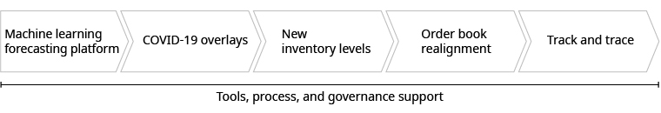
Machine Learning forecasting platform
Covid-19 overlays
New inventory levels
Order book realignment
Track and Trace

